Slide 1
Advanced web scraping
Using jupyter for automated data collection

Slide 2
Last Week’s Assignment
Writing regular expressions

Slide 3
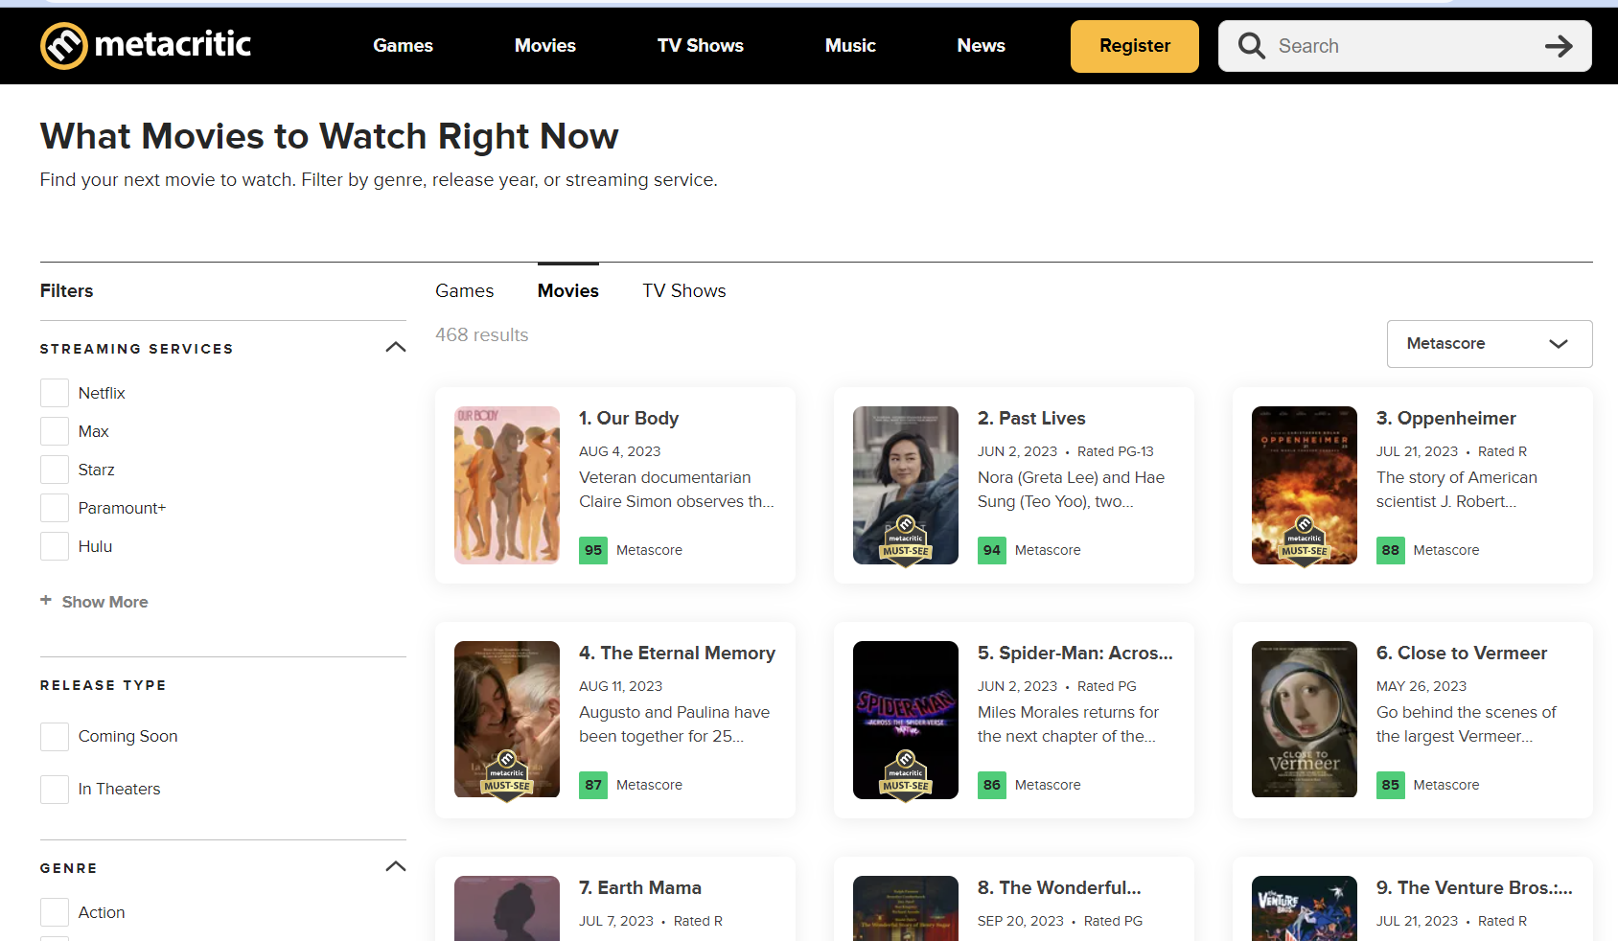
Metacritic site redesign!
Some items are easy to deal with
We can still scrape titles, descriptions, scores
Other items are harder
Search for a specific year no longer works well
Movies without a thumbnail are problematic
Thumbnail URLs used to have “&amp;” in them
Now thumbnail URLs are computed on the fly!
We will focus on what is possible
We won’t gather thumbnail URLs
(To gather them, we’d have to use selenium and DOM parsing – see me after class if interested)

Slide 4
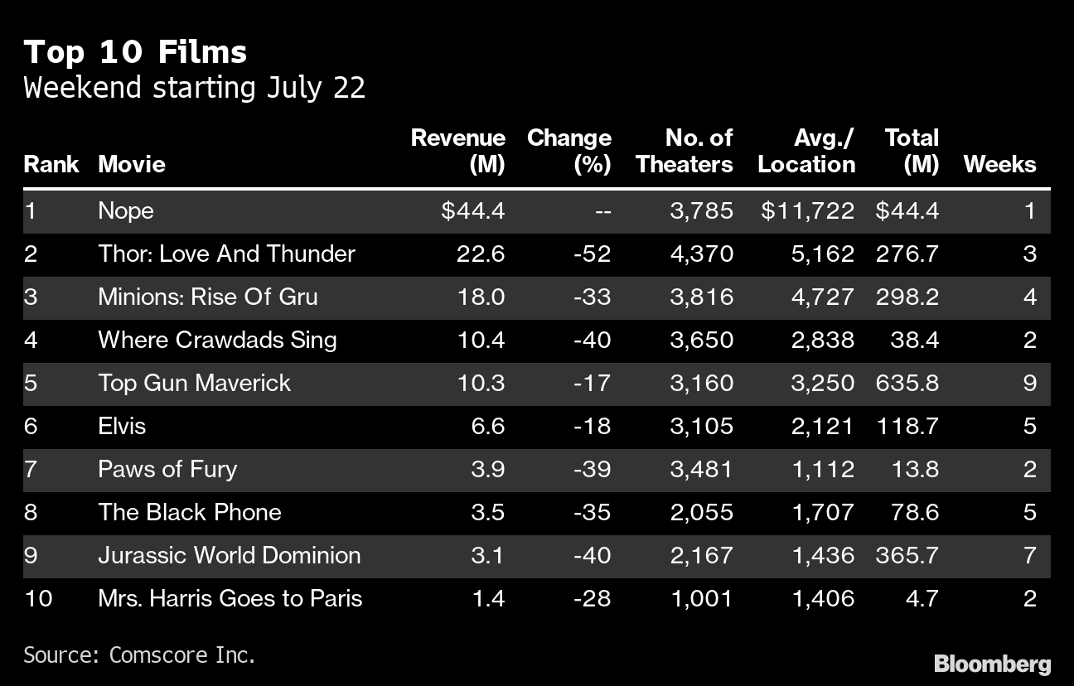
What are we building?
The class project is a data analysis project using movie box office data
Box office data is generally publicly available and rarely considered secret
We will gather data from IMDB and Metacritic
The end result is a Jupyter notebook with charts about movie revenue
We can make realistic and relevant charts with data that is easy to collect and verify
Source: Bloomberg / Comscore - https://www.bloomberg.com/news/articles/2022-07-24/-nope-tops-box-office-in-latest-win-for-director-jordan-peele

Slide 5
Why are you making us learn Regex?
This is one of those really wacky bits of software that has stood the test of time
I learned Regex in the late ‘80s and hated them then
If there was really a better alternative, it would have been created by now
But, it hasn’t, so maybe it’s time to acknowledge that this is a fundamental algorithm
The concept of searching has changed a lot but the technology hasn’t
Most importantly:
You can write and test regular expressions by hand …
And then automate them! (more on that in a moment)

Slide 6
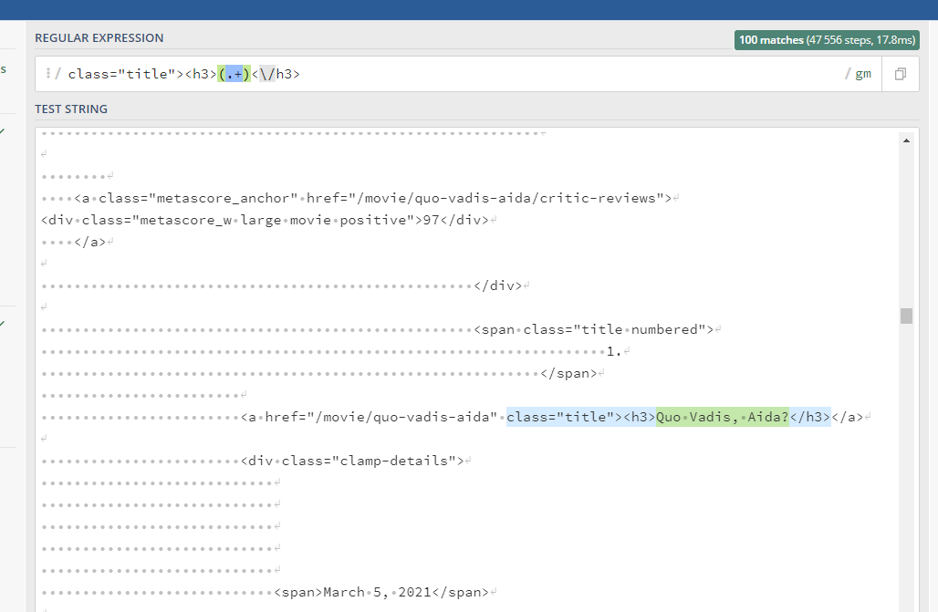
How does the professor write regex?
Find the thing you want in the text manually
Try to identify a bit of text leading up to the thing you want that seems unique
In this case, the uniqueness is “class=title”
The goal is to make sure that this unique bit of text only appears once for each result you want
Without uniqueness, your regular expressions will be brittle and might stop working
Identify a little bit of text afterwards that seems unique
This is less critical – the only requirement is that it won’t appear within the text itself

Slide 7
Useful information
The beginning is easy to find
We can be pretty sure that only titles will have “class=title” in them
The capture group
Usually (.*) but sometimes (.*?)
The ending is less easy
But then again, we know that no movies have ever had </h3> in their name, right?
If any of your text has symbols in it, remember to escape them with backslashes – they must be encoded to work in a regular expression

Slide 8
What is “Escaping” or “Encoding”?
Programmers often need to use text and special characters at the same time
Text is data
Special characters control the program
If text contains a special character, how does the computer know which is which?
The answer is encoding
The computer is in a “mode” – and the use of a special escape character switches modes
Examples:
\s -> Instead of searching for a backslash followed by an S, search for any whitespace character
\B -> Search for a word boundary
\\ -> Two backslashes mean search for a backslash!

Slide 9
What are we going to do with regex?
Now that we’ve written these regular expressions, we’re going to automate them!
Let’s get started downloading some tools that will let us use regex to do work.
Our software will take the regular expressions we wrote and apply them automatically to solve lots of problems for us!

Slide 10
Automating data collection
Tools and techniques we use

Slide 11
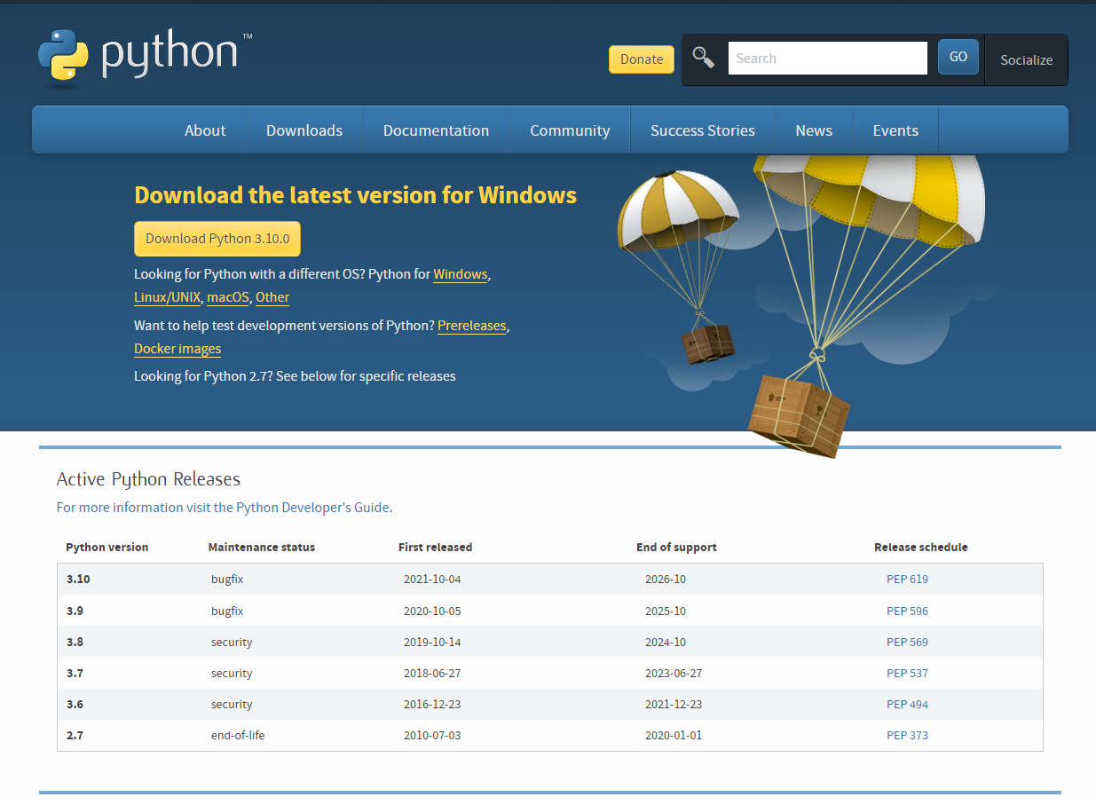
Install Python (Windows)
https://www.python.org/downloads/
Install from the python.org website
DO NOT use the Microsoft Store version
Make sure to reboot computer after
Check that it installed successfully
Launch PowerShell
Run python --version
If it succeeded, you’ll get 3.10 or higher
If it fails, https://datatofish.com/add-python-to-windows-path/

Slide 12
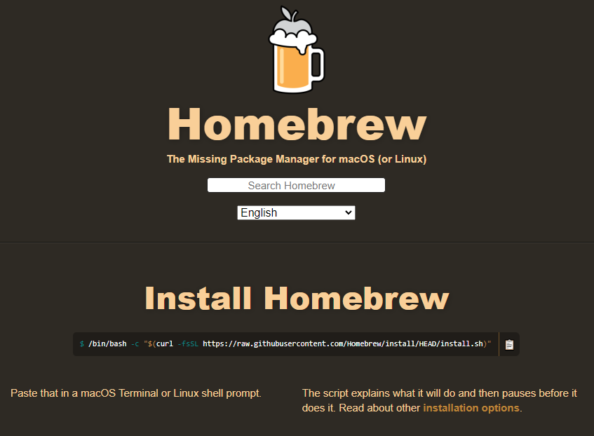
Install Python (Mac)
You want to use the “Homebrew Package Manager”
Visit https://brew.sh/
Run the install instructions provided
Reboot your mac
After reboot
brew install python
python --version
If it succeeded, you’ll get 3.10 or higher
If you get version 2.X, try running python3 --version

Slide 13
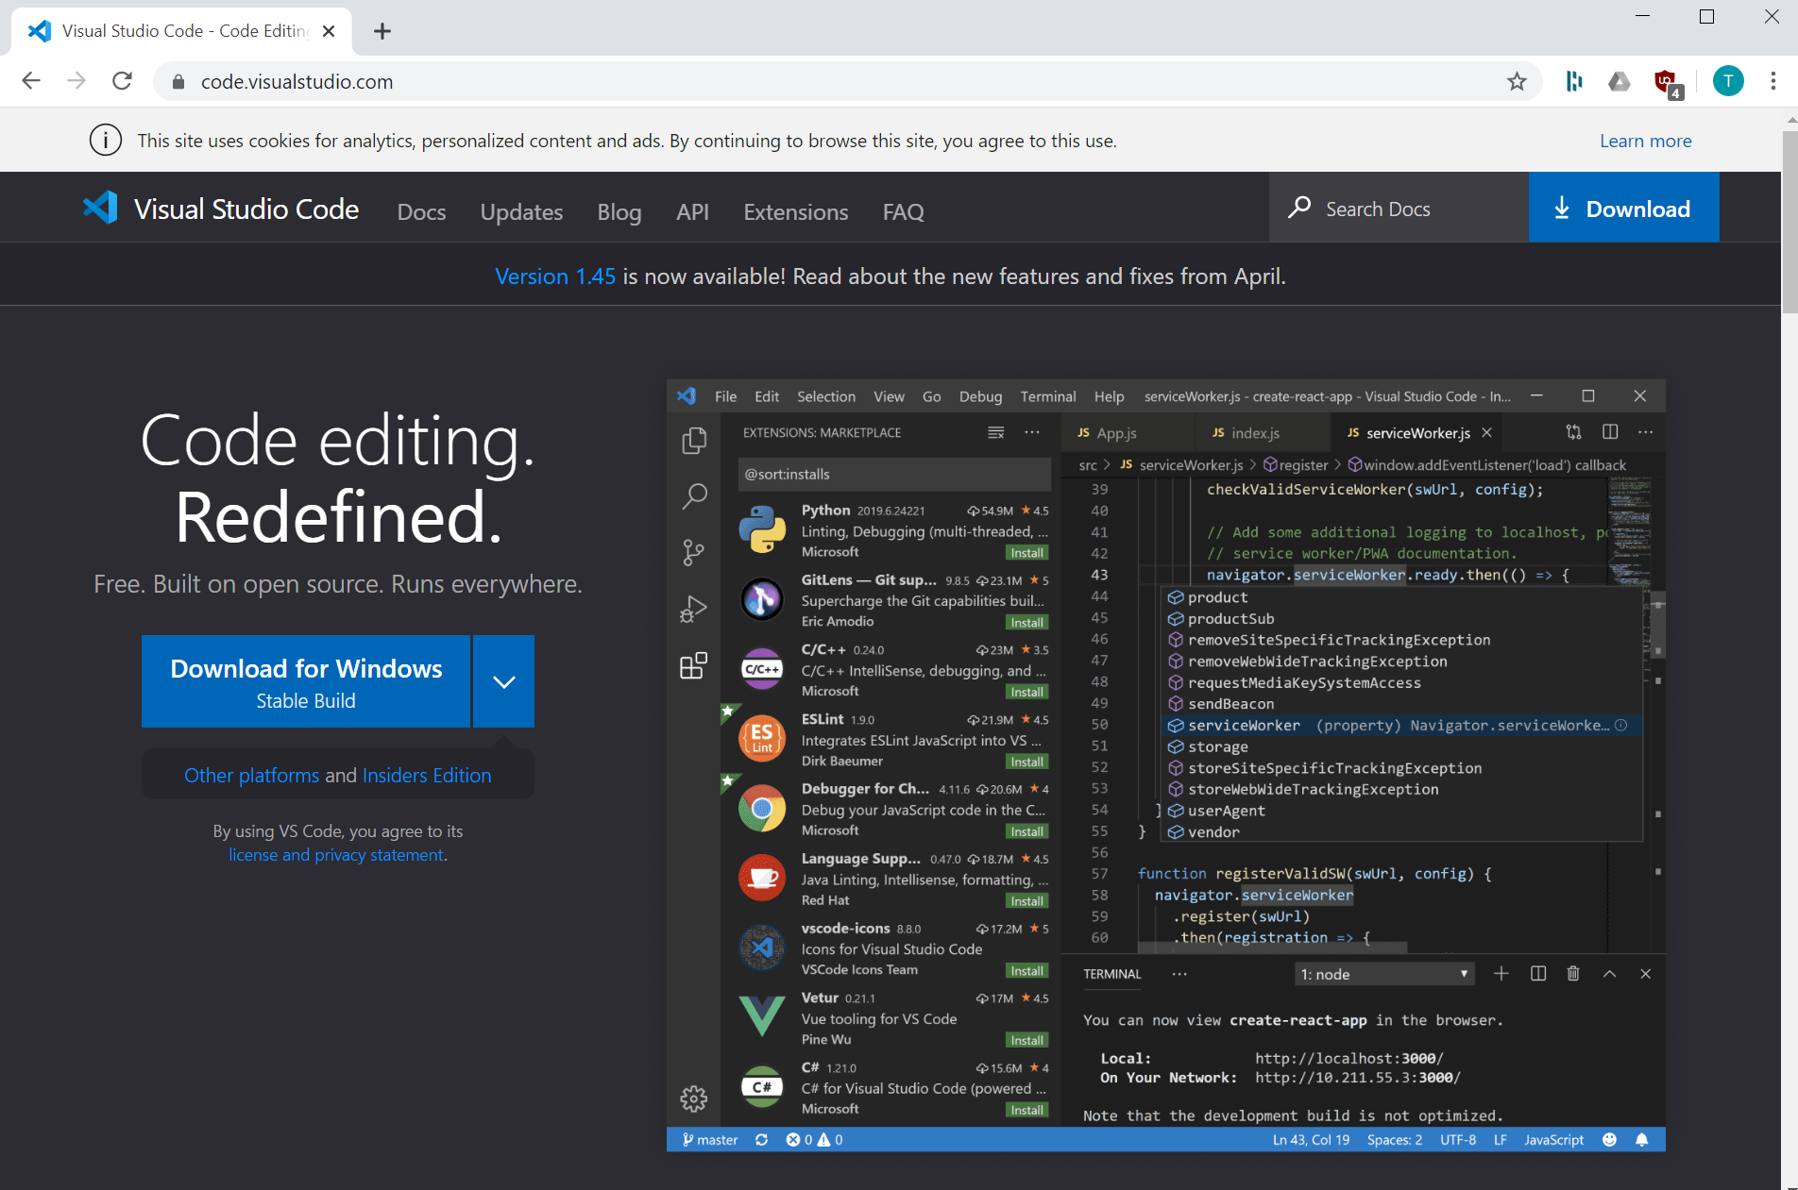
Visual Studio Code Editor
An open-source platform for tools
Because it is open, chances are someone has already created a plugin to help with whatever you’re doing
https://code.visualstudio.com and click download
Works on Linux, PC, and Mac
Includes support for Jupyter notebooks!
We’ll use a VS Code Extension

Slide 14
Creating your project
Steps to set up a jupyter project

Slide 15
Putting it all together
Here’s what we’re going to do:
Create a folder on our computer
Open the folder in the Jupyter extension in Visual Studio Code
Create a notebook
Put our regular expressions from week 1 into a scraper
Automating large data collection
When you have a small technique that works, Jupyter allows you to test it and reuse it
If we can gather data for one page, we can gather data for multiple pages with a loop
Eventually we’ll save this data in a shared location like a database (next week!)

Slide 16
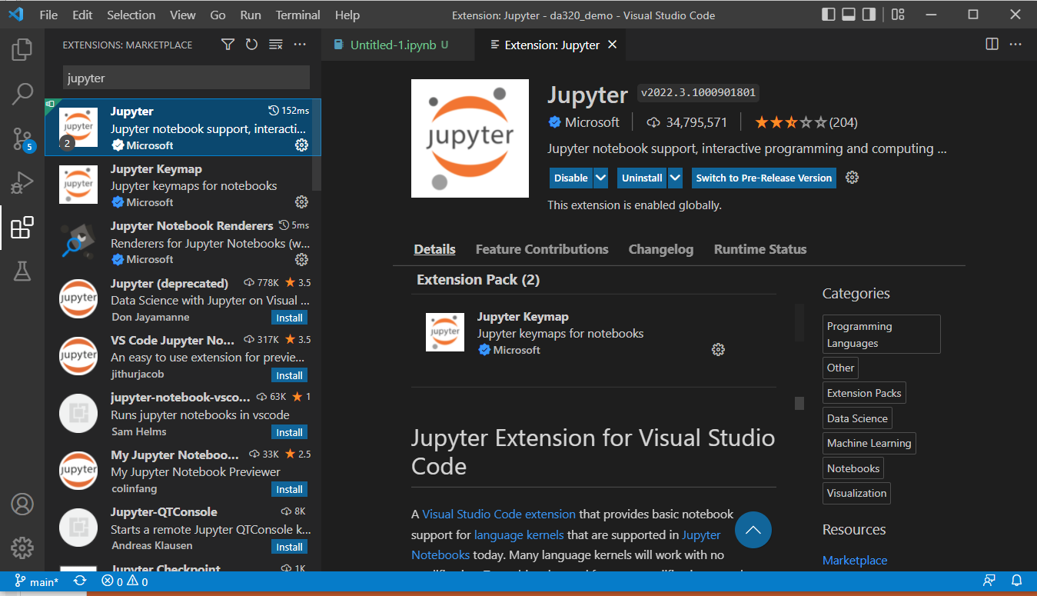
Install Jupyter extension in VS Code
In Visual Studio Code, click on the three-boxes icon on the left-hand side
In the “Extension Marketplace” box, type “Jupyter” and click search
Find the official Microsoft Jupyter extension and click “Install”

Slide 17
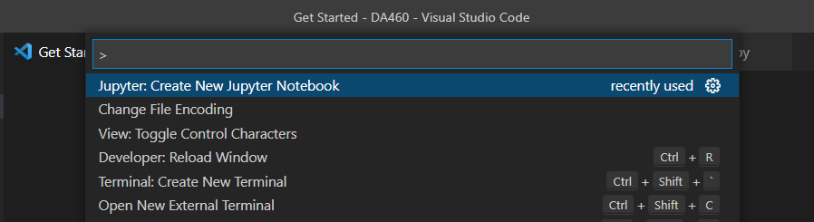
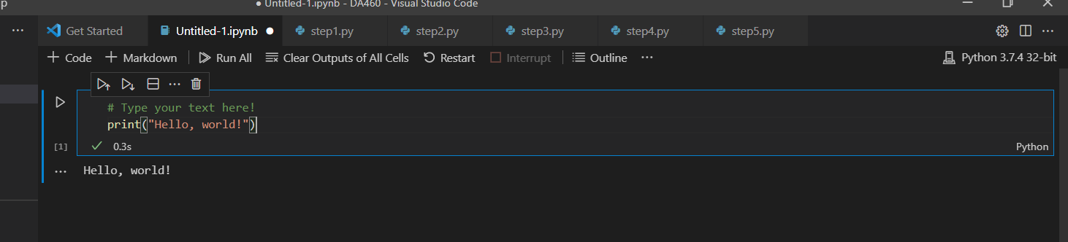
Create a Jupyter Notebook
Open the Command Palette
On Windows Ctrl+Shift+P
On Mac Cmd+Shift+P
The palette is keyboard based and can do everything
Type or find the palette action “Create New Jupyter Notebook”
Type into a Jupyter code box this command:
print(“Hello, world!”)

Slide 18
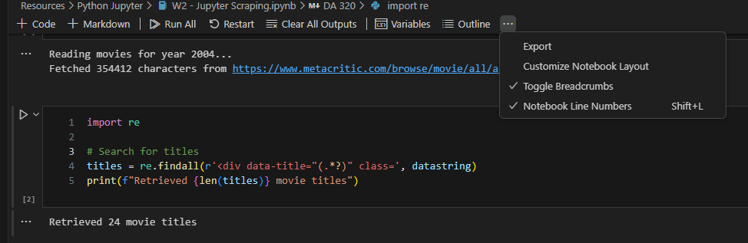
Turn on “Notebook Line Numbers”
This feature allows the professor to look at your screen when you’re sharing code and tell you where a problem is
Without notebook line numbers, I struggle to help people during office hours!
Click on … menu, then select Notebook Line Numbers
If it works, you’ll see line numbers to the left of each bit of text!

Slide 19
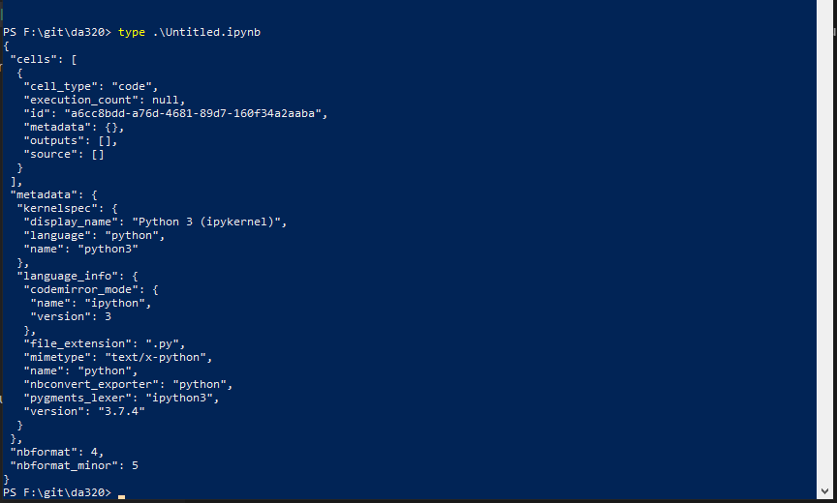
What did we just do?
Jupyter created a notebook for you
It’s basically a scratchpad where we can do some work
We haven’t done anything yet
But, the notebook is essentially a JSON file
It has code and data in it
You can share this small text file with others
They can build on your work

Slide 20
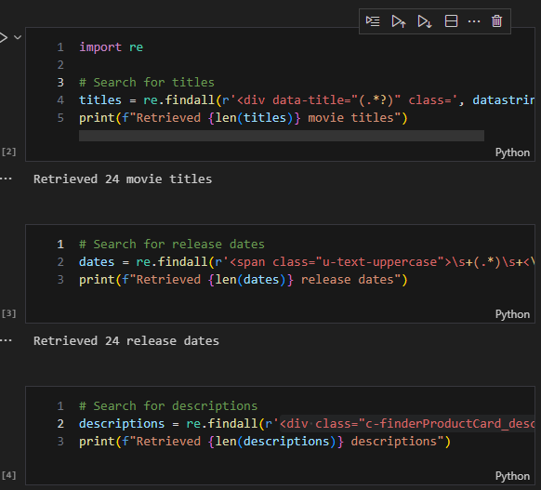
Good and bad notebooks
A good notebook uses small blocks of code; a bad one uses a single block of code
If you write a big notebook with a single block of code, you should not be using Jupyter
Each block of code must do the following:
Have a clear purpose
Do a small piece of work
Print out some results so you can test it
If you submit a notebook that is a single block of code, I will deduct points

Slide 21
What is a “Notebook”?
Understanding the jupyter model of research

Slide 22
More powerful than R, easier than C++
R usage is gradually declining among the computer science field
Python is a comprehensive programming language, and it has a healthy ecosystem
Researchers can use the Python ecosystem to write powerful research
Use Python libraries written in C++ for GPU parallel processing streams for machine learning
Find answers for their problems on StackOverflow
Publish packages on PyPi, an open repository managed by the Python foundation
Python gets us the power of the best available software engineers with very little effort
Jupyter is a REPL program - a Read-Evaluate-Print Loop – which makes it easy to experiment

Slide 23
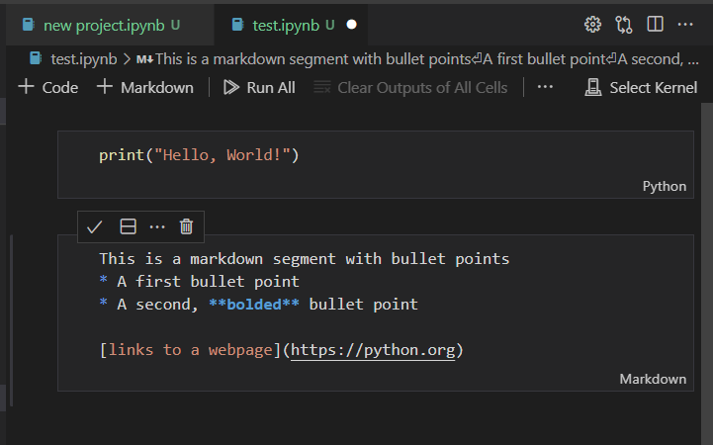
A mixture of writing and research
Notebooks have both text and code segments
The code can be executed at any time
You can mix your research with instructions on how to recreate your research!
Markdown allows you to write nicer papers
Some analysts publish via notebooks!
It’s the same system as used in your GitHub repository readme file
https://www.markdownguide.org/cheat-sheet/

Slide 24
Working with code in your notebook
Actions are in the navigation bar at the top
+Code – Add a new code segment
+Markdown – Add a new markdown segment
Run All – Run all code segments
Clear Outputs
Select Kernel – Choose which version of Python you use
If something doesn’t work right, edit it and click run again!
Read the error messages; they tell you what went wrong

Slide 25
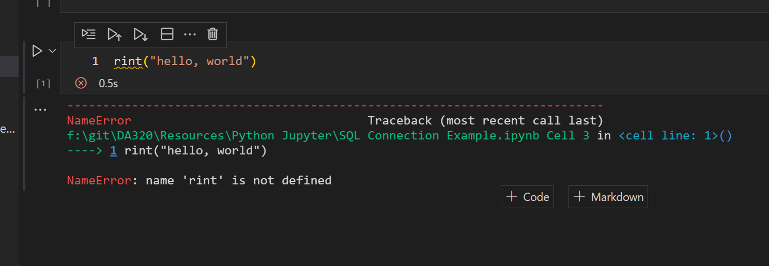
Understanding error messages
Oh, I see the typo!
This tells me the error is on line 1
What’s “rint”? I wanted “print!”

Slide 26
Real World Jupyter
Gathering text from a website

Slide 27
What do I want my program to do?
Think: What did I do?
Right Click -> View Source
Copy the text of the webpage
Paste into Regex 101
Use a regular expression to extract one field
Repeat for all four fields
Remember, thumbnail URLs are difficult because of the anti-scraping defenses Metacritic added, so we’ll skip that!
Our program will reproduce the same work we did manually, but using automation!
First, we’ll use Python to retrieve the webpage.
Second, we’ll use a regular expression to retrieve a single data field.
Third, we’ll retrieve all the other fields.
Finally, we’ll display the results.

Slide 28
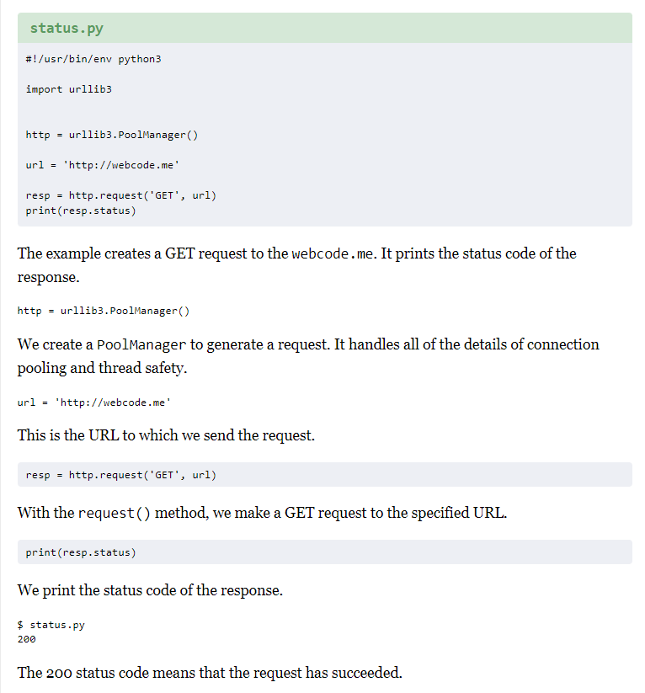
Retrieve data from a website
Despite thirty years of programming, I always start by searching for guides online
Google “Retrieve Webpage Python”
Results: https://zetcode.com/python/urllib3/
Why don’t I know this offhand?
There are just too many things to know
I switch languages and toolkits regularly
It isn’t worth memorizing every possible fact
But when you discover something, blog about it, someone will care!

Slide 29
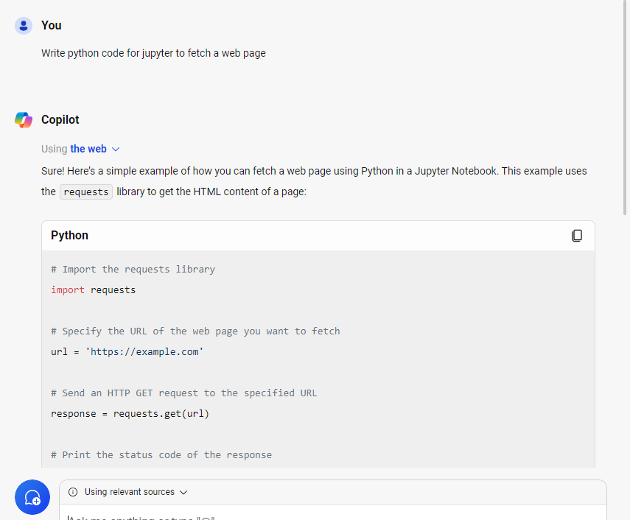
Using ChatGPT!
If you prefer, instead of using a search engine, you can use ChatGPT or other similar AI features to get some simple code
Getting a simple block of code is the most reliable thing AI can do
If you do it, your example may be different than mine!
Try this:
“Write python code for Jupyter to fetch a web page”

Slide 30
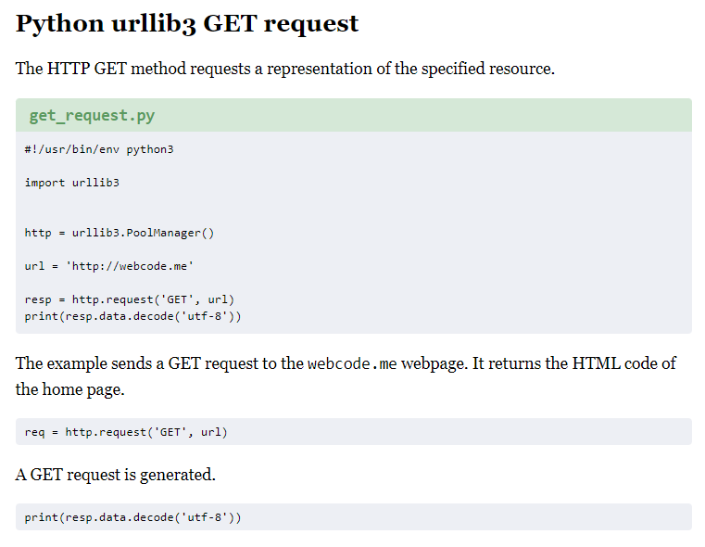
Let’s put this in our notebook
We want to view the page source
But the data comes from urllib3 as bytes
What are bytes?
Raw data from a computer
Needs to be converted to text
What is this mention of ‘decode UTF-8’?
Remember the problems we had with encoding text for a regular expression?
All text has this problem, especially non-English languages
UTF8 is the best solution yet devised for text, but it is not completely universal

Slide 31
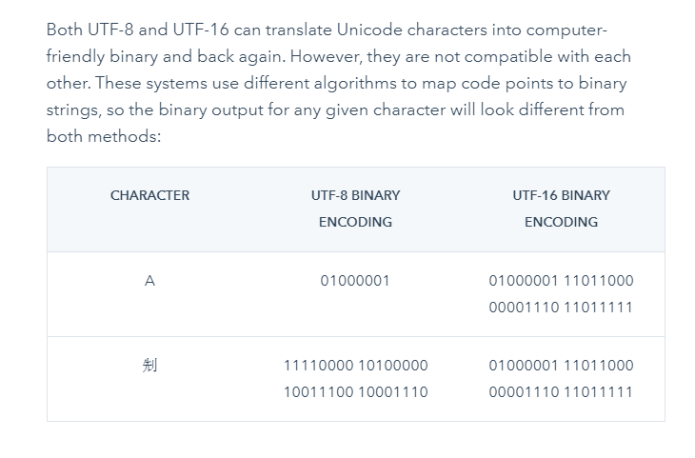
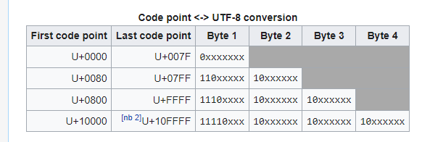
Quick detour: What is “UTF-8”?
Other languages
The world has more than one language
The original developers of ASCII spoke English, and they stored all text in 7 bits
Over time the 8-bit byte became the standard unit of data within a processor
When we wanted to encode other languages, there weren’t enough bits available
UTF-8 allows numbers to be encoded with one byte per character, and ideograms / emoji with multiple bytes
This isn’t technically fair to other languages, but it’s a solution that works and is reliable
Source: Wikipedia and Hubspot
English characters
Emoji

Slide 32
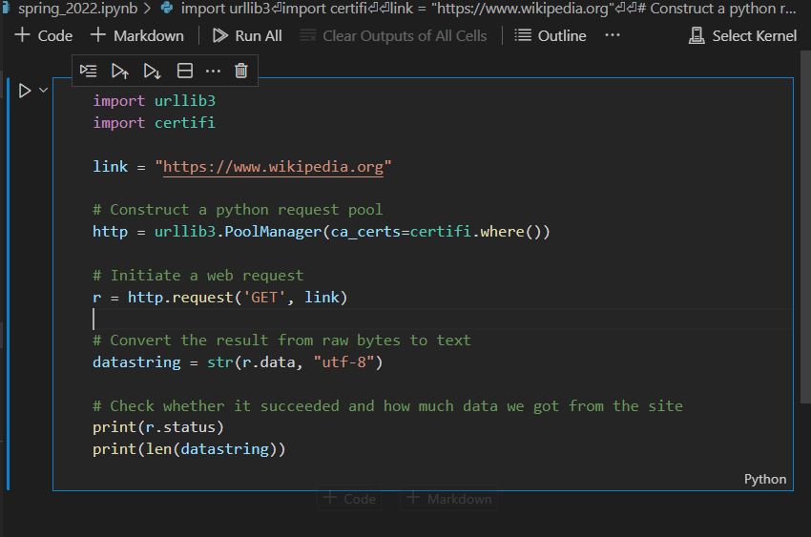
Let’s get back to our notebook
Any line with a # is a comment
I use comments to help myself remember what I’m doing
I often write code and then forget the details
When I go back to it six months later, the comments help me remember why I’m doing it
Code without comments is horrible
At the end of the work, I print the results
Reminder: It’s okay if your code looks different from mine!

Slide 33
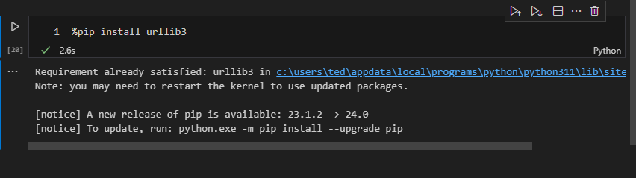
Installing a Python library in Jupyter
If you see a yellow squiggly, that means that you don’t have that library in your computer
You need to install it with a new code block using %pip install <library>

Slide 34
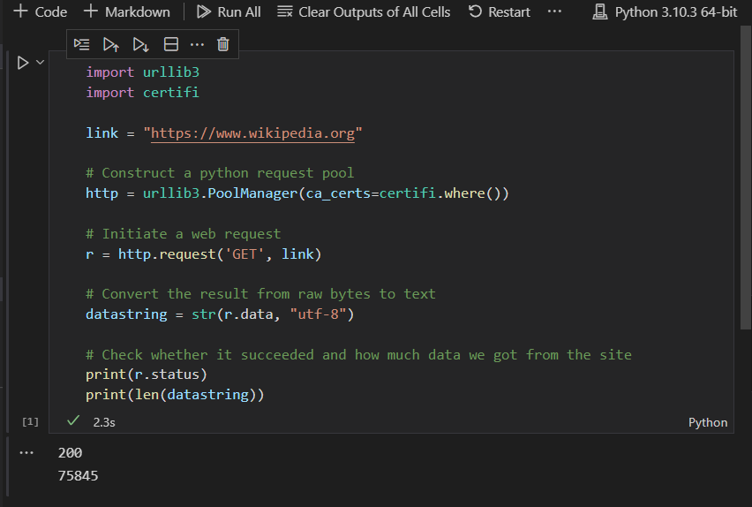
Let’s try executing our workbook
I press the “Run All” button and Python executes my code
The results that I printed out show up at the end
Wait: What the heck are “200” and “75845”?
These numbers on their own are confusing
200 = HTTP OK, a successful web request
75845 = The number of characters in the page
Let’s make our results more interesting than just two numbers!

Slide 35
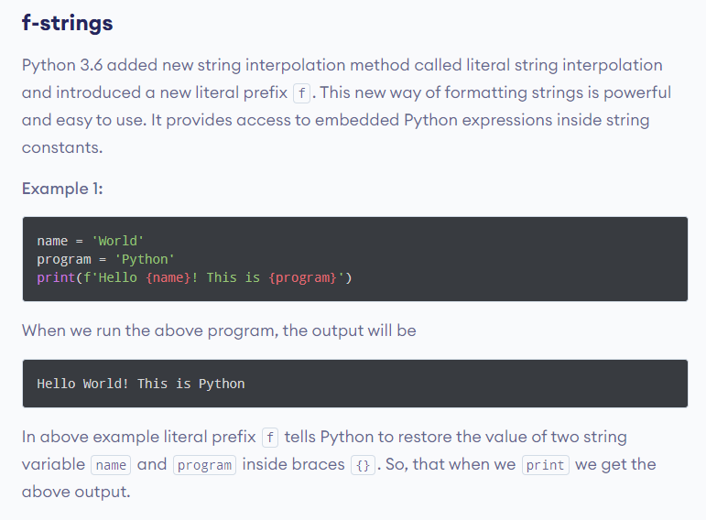
Making our output readable
We can give our output context by printing text with filled-in variables
Kind of like a “mad lib”
Instead of printing text with print(“text”):
Use print(f”text”)
In your text, you can place variables surrounded by curly braces { }
Looks like this: print(f”My name is {name}”)
Source: https://www.programiz.com/python-programming/string-interpolation

Slide 36
Why does “Encoding” keep showing up?
When you are writing text, it’s just text
But when you’re working with software or data, you need to know how the data is formatted.
Encoding is how we ensure that data is clearly identified and separated.
For regular expressions backslashes, periods, and brackets are among the special encoding characters
For markdown, hash tags (#) and asterisks are used for encoding comments and bullet lists
For UTF-8, high bits and extra bytes are used to distinguish emoji from other types of text
In CSV files, commas, tabs, and double quotes are used to separate one text field from another
In Python formatting strings, curly braces {} are used to separate fields from text
As an data scientist, you’ll need to understand what distinguishes formatting from text

Slide 37
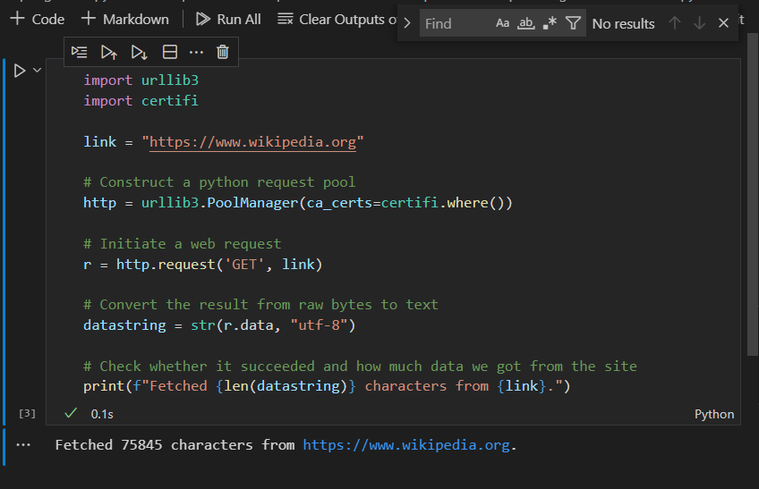
Using string interpolation
Your text string now starts with “f”
Within an f-string, you can put variables anywhere in curly braces {}
Python will automatically fill in the blanks with the data for you
Note that the workbook automatically color codes things so you can tell what is text and what is a variable

Slide 38
Python Regular Expressions
Scanning text to find things

Slide 39
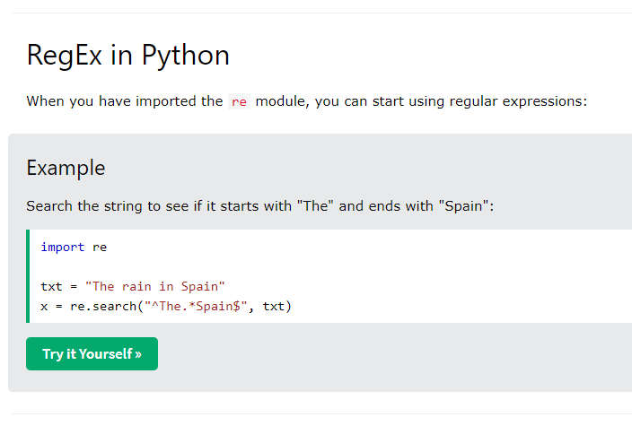
Basic regex search in Python
I forgot how to do it!
Let’s google search “regex in python”
Ah! There’s an import statement and a search statement
We can test this in our notebook
Source: https://www.w3schools.com/python/python_regex.asp

Slide 40
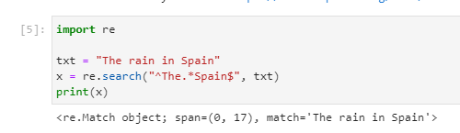
What is a Python regex match?
When you print it, it says it is an “object”
That’s because regular expressions capture lots of information
Notice it has multiple things:
The object itself
The span where the match was found
Start character within the string
Length of characters within the string
The exact text of the match

Slide 41
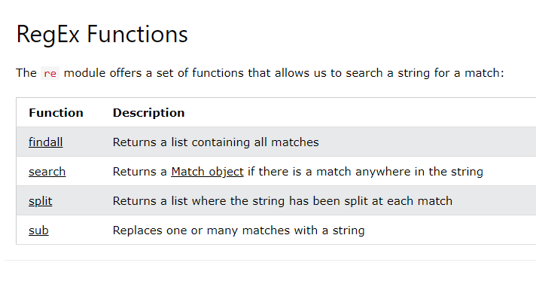
So how will we do web scraping?
We’ll use a Python regex feature called findall which works with capture groups
We just browse around until we find something
In last week’s assignment, you created capture groups, so this is a perfect fit

Slide 42
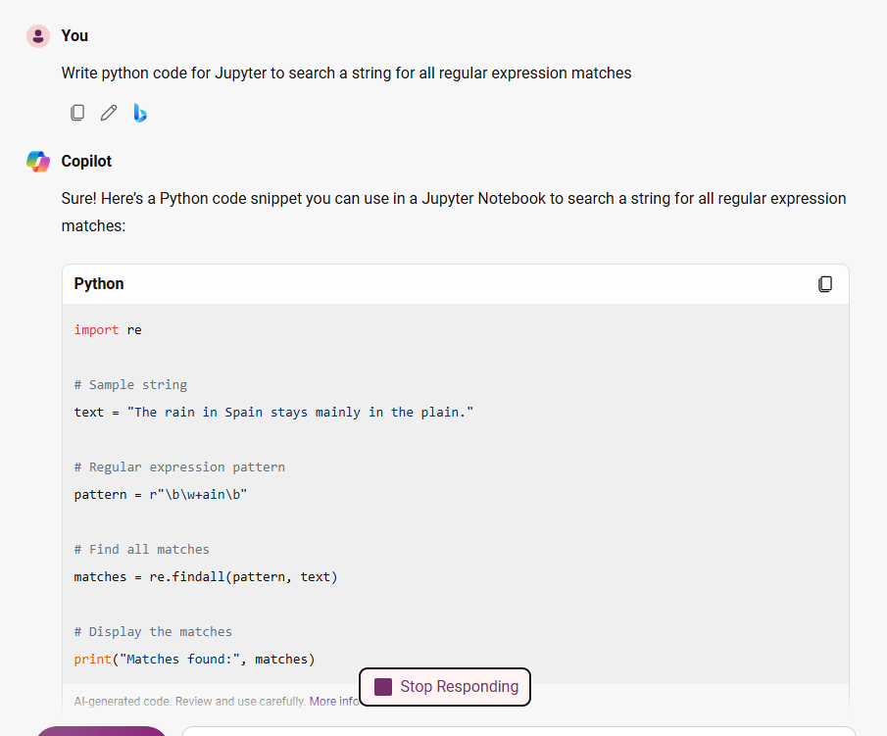
Using ChatGPT!
If you prefer, instead of using a search engine, you can use ChatGPT or other similar AI features to get some simple code
Getting a simple block of code is the most reliable thing AI can do
If you do it, your example may be different than mine!
Try this:
“Write python code for Jupyter to search a string for all regular expression matches”

Slide 43
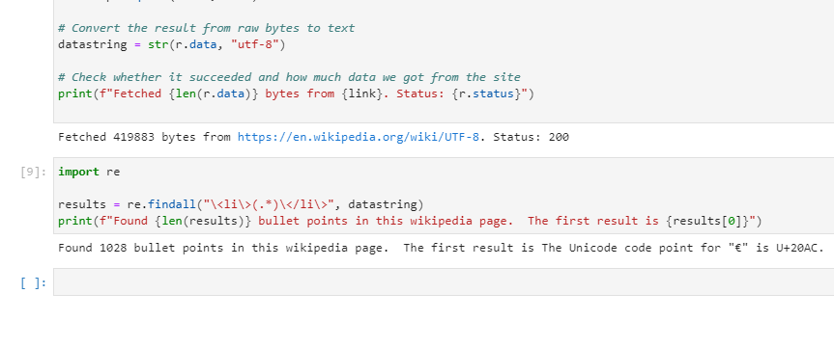
Let’s try searching for all bullet points

Slide 44
Alright, you know everything you need
Last week, you practiced regexes:
Fetched a webpage manually
Wrote a regex to find data (movie title, description, release date, score, thumbnail)
Gathered the results by hand and saved to excel
This week you learned how to:
Create a Python notebook in Jupyter
Fetch the text of a webpage using urllib3
Scan text to find matches using re
Print out the results
Let’s automate everything we did last week in Jupyter!

Slide 45
Weekly Assignment
Turn last week’s regular expressions into a notebook

Slide 46
Install Visual Studio Code and Python
We went through this in class – you followed along, right?
Get Jupyter working using Visual Studio Code
Create a notebook that automates the work you did in week one
Make sure if you run your notebook from the beginning that it produces all the work
Upload your Jupyter notebook to the assignment page

Slide 47
Create a Jupyter notebook for scraping
Your Jupyter notebook should do the following
Load the metacritic movies by year page for a year
Use regular expressions you wrote last week to parse data
Print the data out in a way that looks appealing
You don’t need to do the following
Write optimized code – that’s okay! It doesn’t need to be fast
Write perfect formatting – I will accept anything readable!
Become a Python wizard – it’s okay to just mix together help from each other
Best way to succeed?
Write questions in the student discussion!
Share notes and ideas!
Solve the assignment as a team rather than as an individual!

Slide 48
What should your notebook do?
Weekly Assignment
5 points: Your Jupyter notebook is clearly written with comments and clear output
5 points: Your notebook successfully captures all data points specified in the assignment
Homework Discussion Board
5 points: You participated in this week’s homework board
Common problems:
You wrote the notebook, but you didn’t test it
You gathered data but it doesn’t match up – the metascore for movie A is matched to the title for B

Slide 49
Common problems and answers
Some articles I’ve written with helpful advice:
https://medium.com/tedspence-com/teaching-python-and-jupyter-cbffb68e2194
https://medium.com/codex/practical-data-analytics-for-movies-89f44d04712d
https://medium.com/codex/what-makes-a-jupyter-notebook-good-45ab30623f24
My GitHub repository has lots of helpful examples:
https://github.com/tspence/data-analysis-class-resources
We’ll talk more GitHub next week!
Some techniques you should understand:
Edit, run, review results – this is the debugging cycle
Spot checks – after you gather some data, look at a random movie – is its data correct?
Try running the code against a different year and see if it still works
If something seems weird, share it on the student discussion board!

Slide 50

Any questions?

